Slide 1
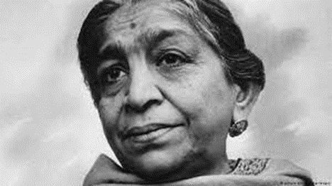

Slide 7
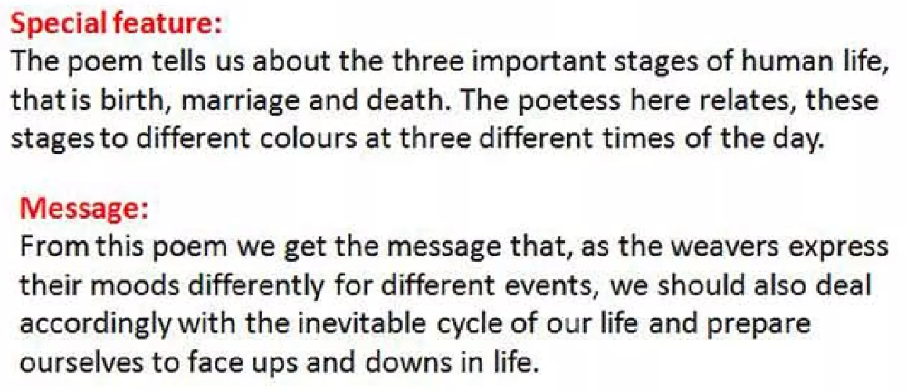
Nithya Prakash /FACULTY/English/SNSACD

Slide 14
Nithya Prakash /FACULTY/English/SNSACD

